Slide 1
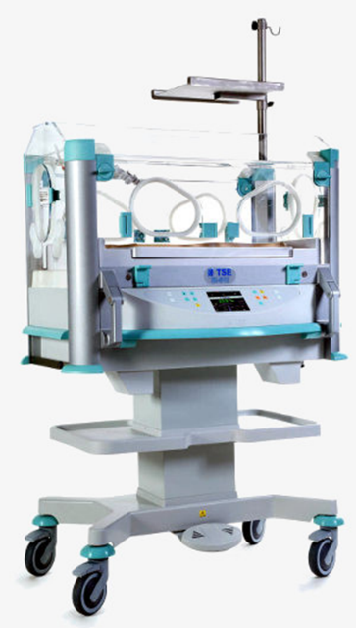
Infant and transport incubator
principles of operation
function
use
scientific principles
construction
components
system diagram
inputs/outputs
trouble shooting
identifying common faults
replacing components
rectifying faults
preventive maintenance
replacing parts
calibration
safety considerations
user and patient safety
electrical safety
Performance monitoring
calibration
18.2.6 Maintain an infant and transport incubator
Unit C 18.2 Maintaining Gynaecology and Obstetrics equipment
Module 279 19 C Medical Instrumentation II
©
dr. Chris R. Mol, BME, NORTEC, 2015

Slide 2
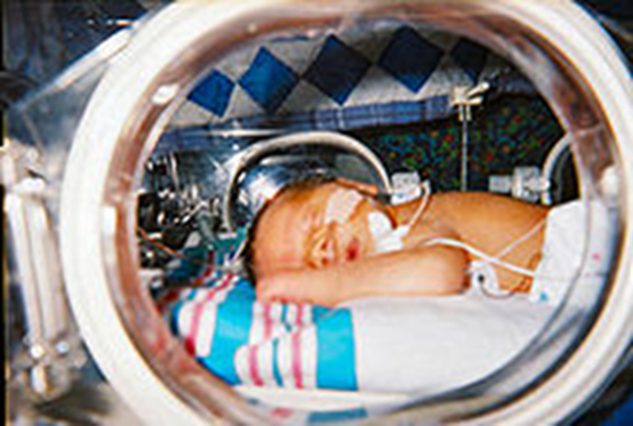
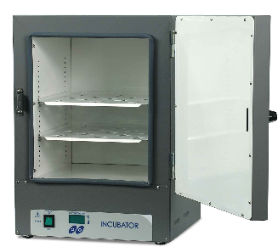
Function
An infant incubator is a chamber which provides a protective, isolated environment for new-born babies. These include premature babies (born too early) which are still small and weak as well as unhealthy full-term babies.
The branch of medicine that deals with new-born infants is called neonatology. The medical practitioner who specialises in this area is known as a neonatologist. A new born baby (or infant) is called a neonate.
Paediatrics is the branch of medicine that deals with the medical care of all children in general, from birth up to 18 years of age. The medical practitioner in this area is known as a paediatrician.
Infant incubators should not be confused with Laboratory incubators, which are used to keep reagents or samples warm
©
Incubator
dr. Chris R. Mol, BME, NORTEC, 2015

Slide 3
Function
The incubator consists of a transparent cabinet in which the baby is kept in a neutral thermal environment for medical care. This means, that the surrounding air has the optimal temperature so that the baby needs minimal energy to maintain normal body temperature. Normally, babies use a large proportion of their calorific (food) intake to maintain their temperature.
The baby lies on a mattress; the cabinet is closed. The ambient air is fully controlled by the incubator. The cabinet has portholes so that the nurse has access to the baby without opening the cabinet. Under the cabinet is the compartment with the technology and the control panel. The whole incubator is mounted on a trolley.
The infant incubator
controls the temperature (34 - 38°C)
controls the humidity (40 - 80%)
can deliver additional oxygen
protects against infections and diseases
protects against noise
©
Incubator
dr. Chris R. Mol, BME, NORTEC, 2015

Slide 4
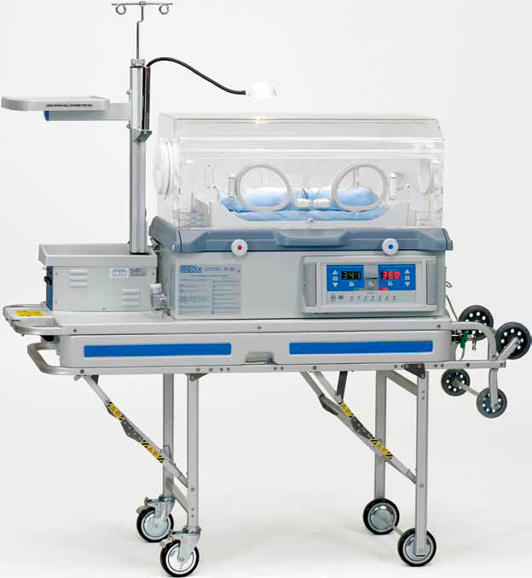
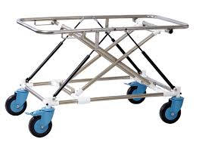
Transport Incubator
A transport incubator is an incubator in a transportable form, and is used when a sick or premature baby is moved, e.g., from one hospital to another, as from a community hospital to a larger medical facility with a proper neonatal intensive-care unit.
On top of the usual temperature and humidity management, it may have the following equipment on board:
miniature ventilator,
cardio-respiratory monitor,
IV pump,
pulse oximeter,
oxygen supply.
©
Incubator
dr. Chris R. Mol, BME, NORTEC, 2015

Slide 5
Use
It is not difficult to operate an infant incubator; the functions are self-explanatory.
Nevertheless the technician and the user have to read the user manual carefully before use.
General rules:
Always pre-heat the incubator and wait for half an hour until temperature and humidity are stabilised.
Babies are kept in the incubator undressed apart from a nappy.
Check and record the temperature every 5 hours and hourly in a critical care stage.
Default air temperature in the incubator is 35°C.
The setting for the humidity for small babies is 70 - 80% in the beginning, later 40%.
Use distilled water only. It has to be drained and renewed every day.
Do not place equipment on top of the incubator.
©
Incubator
dr. Chris R. Mol, BME, NORTEC, 2015

Slide 6
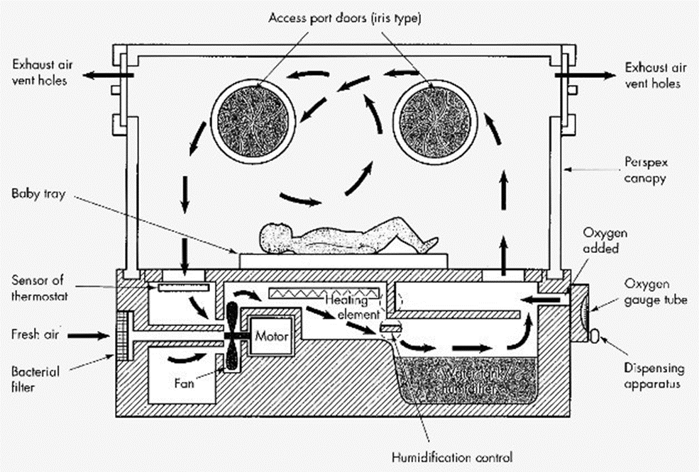
Construction Principles
All infant incubators work on the same principle.
A fan blows filtered ambient air over a heating element and a water container.
Through a control valve additional oxygen can be supplied to the air.
The moistened, heated and oxygen enriched air flows into the cabinet with the baby.
One part of the air escapes from the cabinet through vent holes, another part gets back into the air processing.
©
Incubator
dr. Chris R. Mol, BME, NORTEC, 2015

Slide 7
Construction
The cabinet is made out of transparent plexiglas (perspex). A hinged hood can be opened to put the baby in or take it out. Through portholes in the front the nurse has easy access to the baby without letting out the warm air by opening the hood.
The desired temperature is set by the nurse and is kept stable automatically by the incubator.
Humidity and oxygen concentration are usually controlled manually.
The incubator has a safety switch-off function when the temperature increases above 40°C.
Also an alarm is given when the fan does not turn on or in case the power fails.
The components which are used vary. Older incubators work with electrical controls, newer ones are electronically controlled and the newest generation is microprocessor controlled. But the result is the same - and the old ones are as reliable and precise as the newest ones.
©
Incubator
dr. Chris R. Mol, BME, NORTEC, 2015

Slide 8
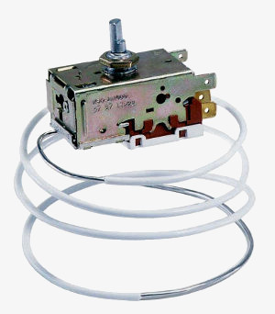
Components
The fan takes the filtered room air and blows it over or through the heating element and the humidifier. Without the fan the heat is not conducted away from the heating element and the incubator overheats.
Simple incubators are equipped with washable foam filters. After washing and drying they can be reused.
Modern incubators usually have disposable bacterial filters. They can not be cleaned and have to be replaced.
A heating element made from coiled resistance wire as known from hair dryers or the tube type (flat or coiled) as seen in autoclaves is used to heat up the air.
The power rating is between 100 W and 300 W (much lower than the heater in an autoclave). The heater is controlled by an electronic temperature control unit via a relay or triac or simply by a thermostat.
©
Incubator
dr. Chris R. Mol, BME, NORTEC, 2015

Slide 9
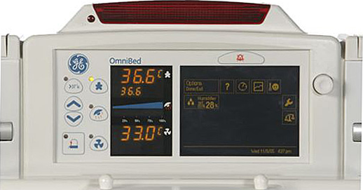
Temperature control
The temperature display should be separate from the temperature control unit. It can be a digital display or an alcohol glass thermometer. For safety reasons mercury thermometers are not used in infant incubators, since mercury is toxic.
Electronically controlled systems have a cable sensor. The output controls a relay (on-off) or a dimmer (variable control). The electronically controlled type has the advantage that an additional temperature sensor can be used. This sensor is taped on the skin of the baby and measures the baby's body temperature.
©
Incubator
dr. Chris R. Mol, BME, NORTEC, 2015

Slide 10
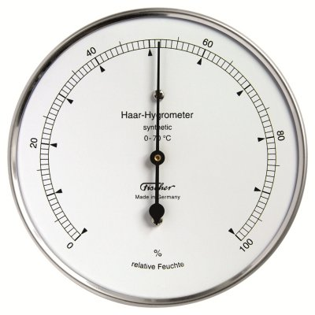
Humidity control
The heated air flows over the water in the water container and gets moistened. The humidity can be regulated by closing and opening a deflector plate over the container. The humidifier must be filled with distilled water in order to avoid corrosive damage to the incubator.
The humidity is measured by a hygrometer, a digital or a traditional dial instrument.
Other incubators have a water heater which creates more humidity, the warmer the water gets.
©
Incubator
dr. Chris R. Mol, BME, NORTEC, 2015

Slide 11
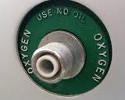
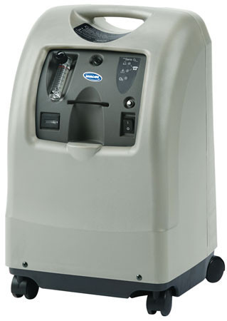
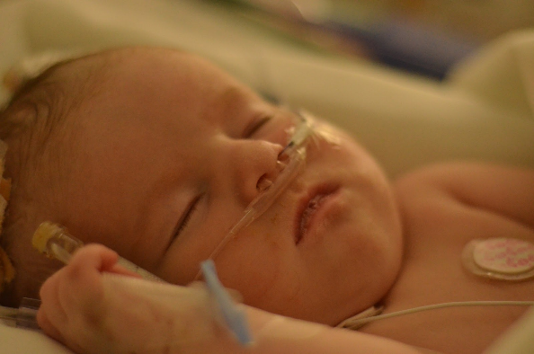
Oxygen control
Most infant incubators have a hose connection to apply additional oxygen from an external cylinder, oxygen concentrator or from the central gas supply. This is used to enrich the air in the incubator with additional oxygen.
Alternatively the baby can get additional oxygen directly via a nasal cannula.
©
Incubator
dr. Chris R. Mol, BME, NORTEC, 2015

Slide 12
Safety features
For safety reasons all electronically controlled infant incubators monitor essential functions.
An alarm is generated when a measurement goes out of range.
The following alarms are available:
Over-heating, when the air in the cabinet becomes too hot.
Fan failure when the fan is not turning any more.
Power off, when the power supply fails (this only works if an
additional alarm battery is present).
In addition to these alarms, all incubators, even the older non-electronic controlled ones have an
Over-heating Protection
The heater is switched completely off when the temperature in the cabinet reaches 40°C.
©
Incubator
dr. Chris R. Mol, BME, NORTEC, 2015

Slide 13
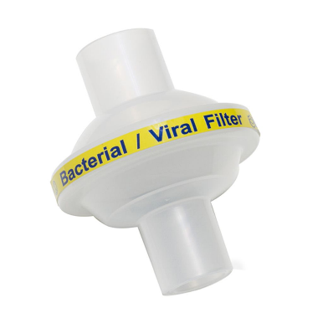
Components
Consumables: some newer infant incubators do not have washable air inlet filters but special bacterial filters. These filters can not be cleaned and have to be exchanged after 3 to 6 months.
Bacterial filters are fine enough to prevent the passage of bacteria (0.5–5 micrometer in diameter). Viruses are considerably smaller, and will pass through a bacterial filter.
Installation: Infant incubators should be placed in a quiet environment with no exposure to direct sun light. Noisy oxygen generators should not be placed beside the incubator. Oxygen cylinders have to be protected against falling over.
©
Incubator
dr. Chris R. Mol, BME, NORTEC, 2015

Slide 14
Common faults
Burned heating elements can be replaced by other types as long as the wattage is the same. Some heating elements are protected by a thermal fuse. It may be that this fuse is blown! Try to find the reason that the heating element or fuse is blown. Check the fan !
When replacing a defective thermostat do not only look at the temperature range but also at the accuracy and the hysteresis. Hysteresis is temperature difference between switching off and switching on. For an incubator a hysteresis of 1°C is needed.
Be careful with thermostats. The thin capillary tube is usually rolled up. This is correct. Do not cut it. It is not a wire, but a fine tube. Also avoid bending the tube. It can get kinks and will not work any more.
Lubrication also helps when the fan gets noisy. Axial computer-type fans have a label in the centre which can be lifted up a bit for lubrication. One drop of oil is enough.
©
Incubator
dr. Chris R. Mol, BME, NORTEC, 2015

Slide 15
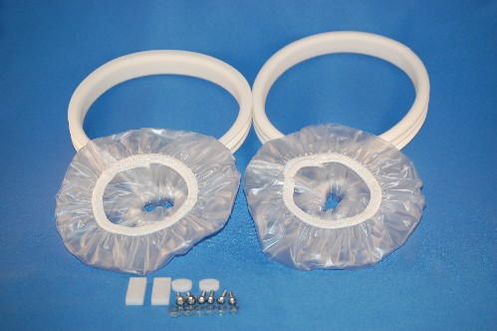
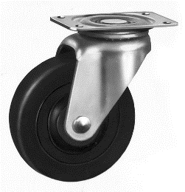
Common faults
Broken thermometers should never be replaced with mercury glass-thermometers. The glass can brake and mercury is toxic.
The sleeves of the ports are often torn, filthy or missing. You can find the material for replacement easily in town.
Casters and brakes are often damaged and spares are difficult to find. But often the incubators are not moved anyway and the casters are not needed. In this case it is a good idea to remove them completely to ensure the incubator is standing stable.
Note: In case of a power cut the incubator does not work any more. A small UPS as used for computers is no solution because the power consumption (of the heater) is too high.
©
Incubator
dr. Chris R. Mol, BME, NORTEC, 2015

Slide 16
Preventive maintenance
Cleaning: the incubator has to be cleaned and disinfected thoroughly after each change of baby and at least once per week.
During cleaning, all components have to be removed and cleaned with hot soap water to which an antiseptic is added. Then the components and the cabinet have to be dried and ventilated before they can be reused. The disinfection products which can be used or should not be used are noted in the user manual.
The humidifier reservoir has to be cleaned and the water changed every day.
The air inlet filter should be changed or washed according to the user manual or every 3 months.
©
Incubator
dr. Chris R. Mol, BME, NORTEC, 2015

Slide 17
Preventive maintenance
Start the maintenance with a visual check. Ensure that the hood is free of cracks and the hinges move smoothly and all switches and knobs are OK. Check all probes, cables, and tubes for cracks and the port sleeves for tears. Check or replace also the alarm battery, if there is one.
Continue with a test run with a function test and a temperature check and a calibration if needed. The temperature check and the calibration procedure are described in the service manual.
When the service manual is not present, a typical temperature check can be performed as follows:
Use a reference thermometer with an accuracy of 0.5° or better and place it in the centre of the mattress.
Set the temperature to 36°C, wait at least 30 min and then check the temperature for 6 hours. The temperatures should not differ more than 1°.
When the temperature differs more, the control unit has to be calibrated. In electronic controls there is always is a trim-pot for doing the adjustments. Mechanical thermostats usually do not have a calibration point. But here the knob or the pointer can be twisted.
©
Incubator
dr. Chris R. Mol, BME, NORTEC, 2015

Slide 18
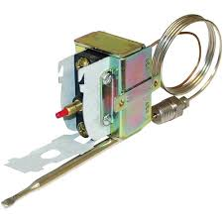
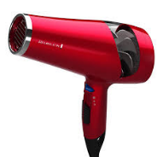
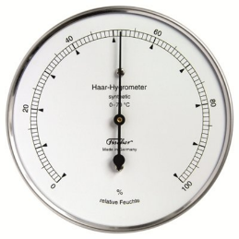
Preventive maintenance
The safety thermostat or over-temperature cut-off can be tested by bypassing the main thermostat. Then the temperature will rise above 40°C and an alarm should be given and the safety function must switch off the heater.
Alternatively, one can to use a hair dryer to warm up the sensor, or to move it closer to the heating element.
Also check the humidity. The incubator should be able to create up to 80% humidity. On the other hand it should be possible to reduce the humidity down to 40%.
An important task during the maintenance is the thorough cleaning of the technology compartment under the cabinet. A vacuum cleaner is useful to clean the inside of the incubator but a brush will also do. Plastic parts and everything that is water resistant should be washed with hot soap water added with antiseptic. Do not forget the air inlet filter.
©
Incubator
dr. Chris R. Mol, BME, NORTEC, 2015

Slide 19
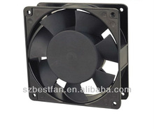
Performance monitoring: calibration
Special tools: a calibrated (electronic) thermometer with an accuracy of 0.1°C is needed.
A clinical (fever) thermometer can not be used because it only shows the maximum temperature.
A hygrometer is needed when the humidity has to be checked.
The fan should not be excessively noisy (below 65 dB). Assuming you don’t have a sound meter with you, try to estimate the noise of the fan with your own ear placed where the baby’s will be. It should be so quiet that you could comfortably hear all the conversations in the room around you.
Well maintained incubators can reach easily 15 years or more.
©
Incubator
dr. Chris R. Mol, BME, NORTEC, 2015

Slide 20
END
The creation of this presentation was supported by a grant from THET:
see https://www.thet.org/

